Slide 1
High precision determination of chiral indices of electron diffraction patterns from carbon nanotubes
Davis Brown

Slide 2
Overview
Why?
Primer on the geometry of carbon nanotubes
Diffraction from nanotubes
Electron diffraction
Determination of chiral indices
Deep learning approach to the determination of chiral indices

Slide 3
Motivation
Sumio Iljima’s 1991 observation of multi-walled carbon nanotubes generated intense interest– single-wall nanotubes two years later
Carbon nanotubes (CNTs) have high ultimate tensile strength, Young’s modulus
A single-wall carbon nanotube can be described by wrapping (rolling) a graphene sheet with a certain cut
Structure– the diameter and chirality, can be uniquely defined by chiral indices (n,m)
Electrical properties: can be semi-conducting or metal-conducting depending on its chiral indices
Can determine chiral indices with an Transmission Electron Microscope (Qin 2006)

Slide 4
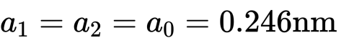
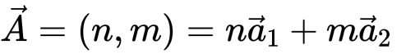
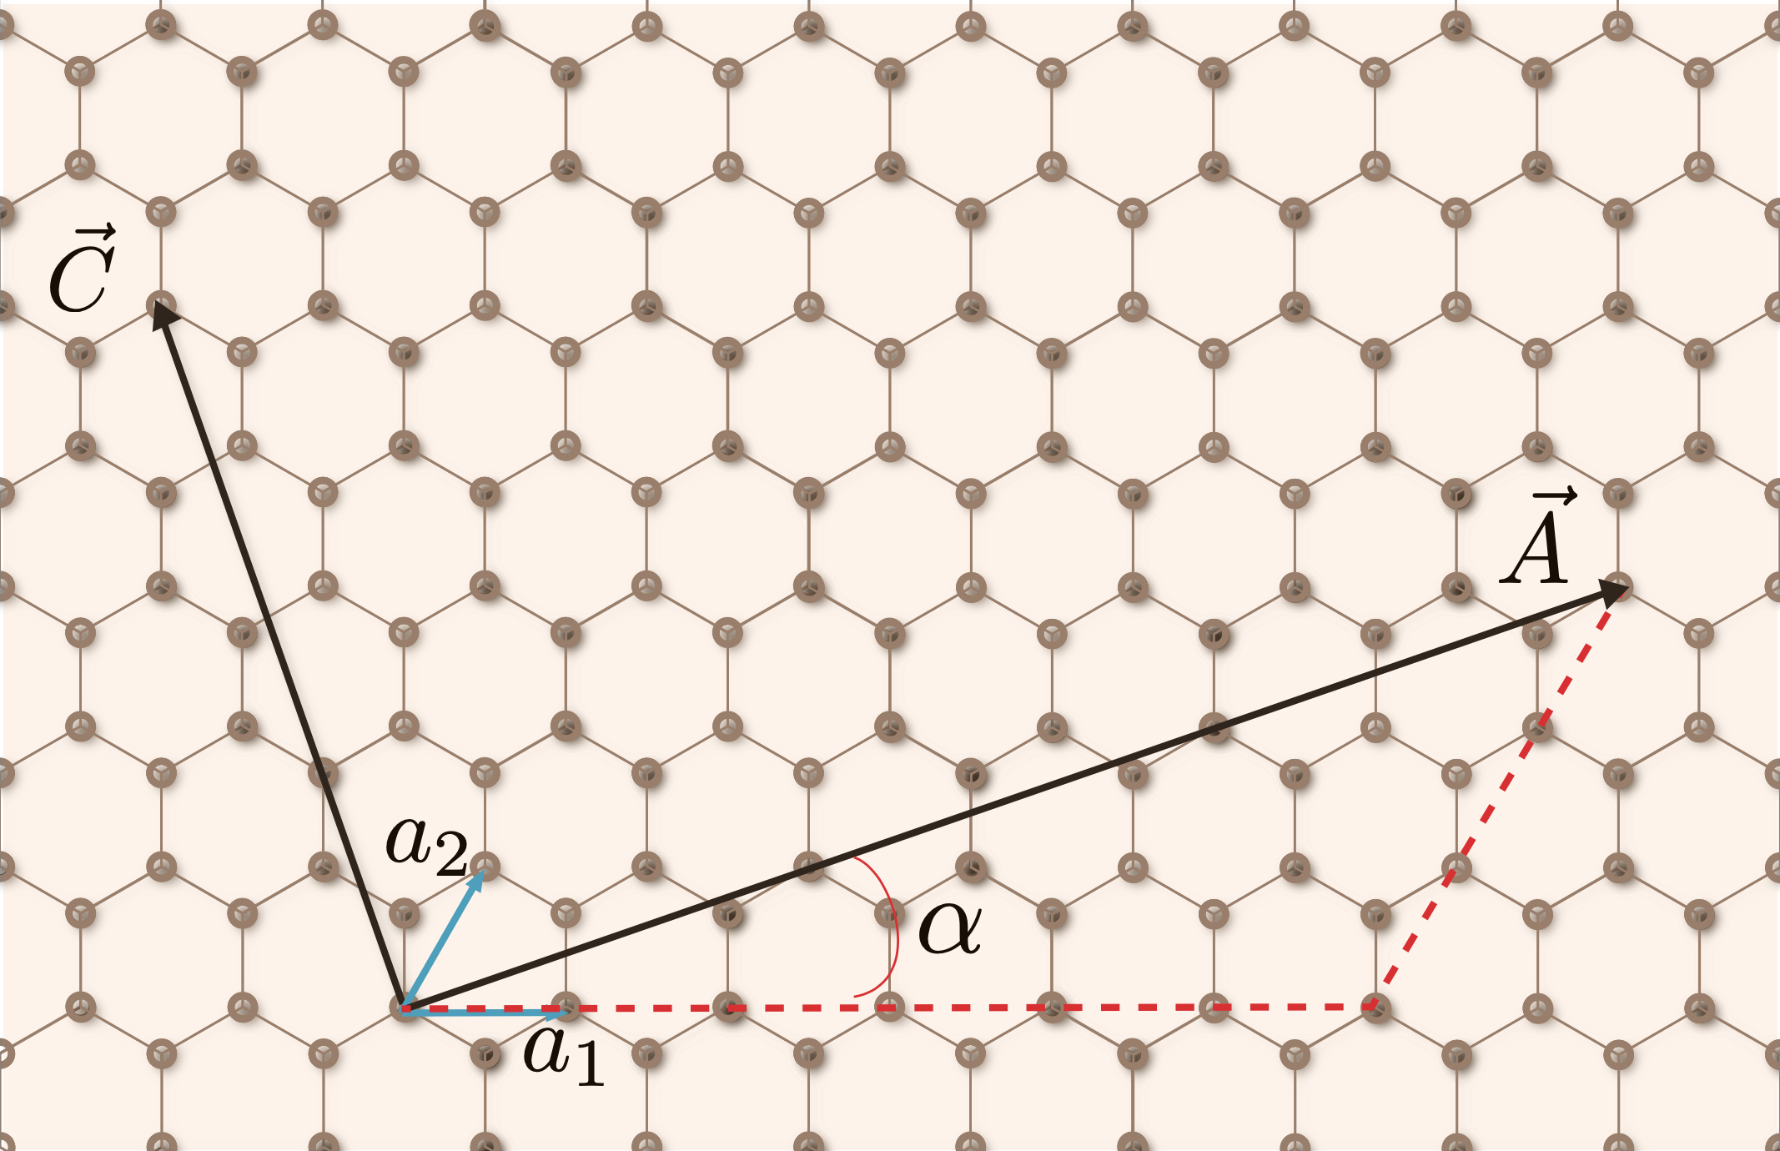
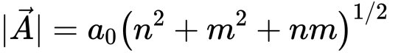
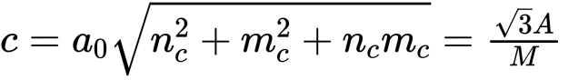
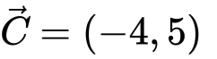
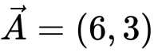
CNT geometry primer
Graphene mesh
Carbon atoms
Tube axis orthogonal to perimeter vector
Periodicity (along tube axis)
Notes:
Perfect hexagonal mesh, inter-angle 60 degree
The indices of the tube axis (nc, mc) are chosen such, that the only common divisor is 1. With the greatest common divisor M of (2n + m) and (n + 2m), one gets the axial lattice vector (nc, mc)
Formed by rolling up about tube axis, axis c, perpendicular to chiral axis

Slide 5
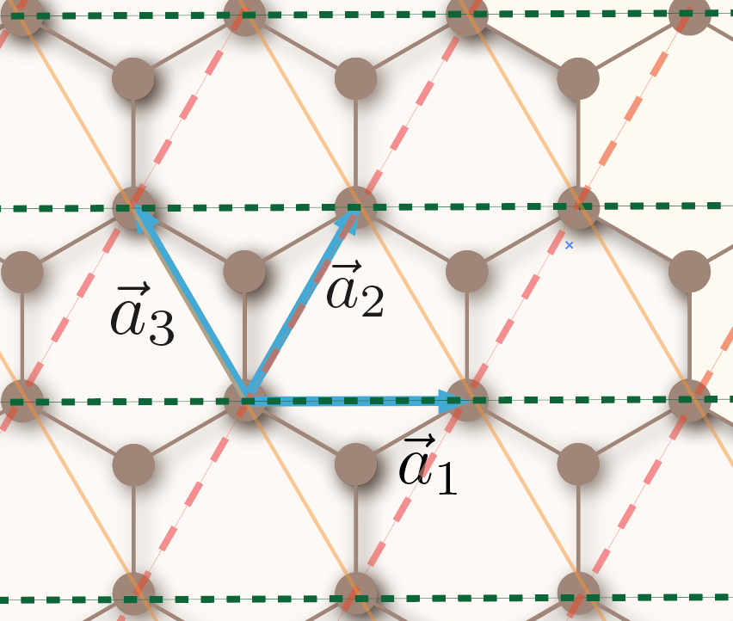
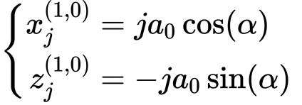
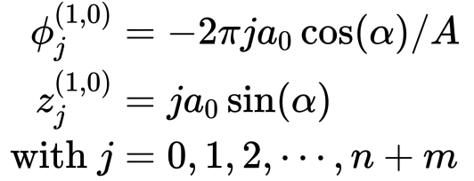
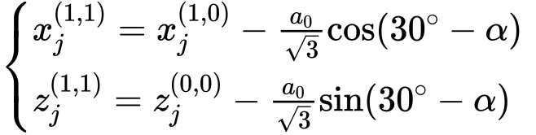
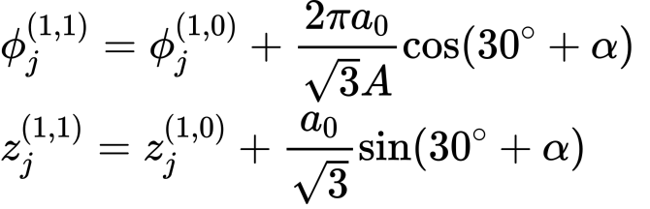
Positions of atoms on primary helices
Can define three equivalent molecular helices (each with a pair of carbon atoms). Consider radial projection, then express in cylindrical coordinates.
Primary helix for a₁
Secondary helix for a₁

Slide 6
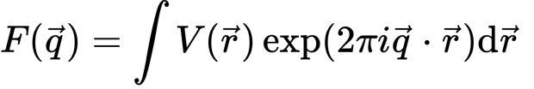
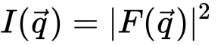
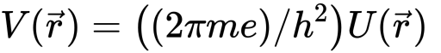
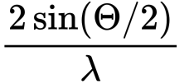
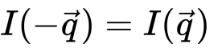
Diffraction of CNT: structure factor in polar coordinates
The structure factor describes how incident radiation is scattered. For an electron, the scattering amplitude with the Born approximation is
We can rewrite in polar coordinates,
From Fourier expansion of iterating structure with period c in direction of the z-axis
Notes:
Note that we cannot calculate F from the intensity. Only the scalar magnitude of F, |F|, and not the complex scattering factor F itself is available to us directly from the experiment. This is the root cause of the phase problem.
Friedel’s law and centrosommatic

Slide 7
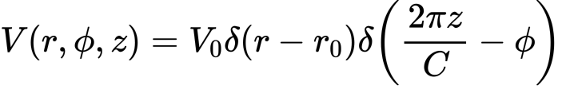
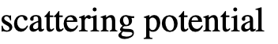
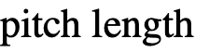
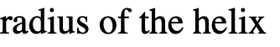
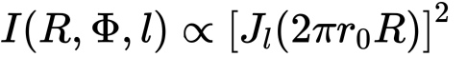
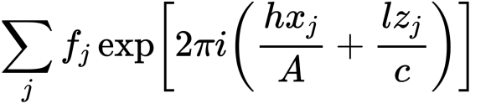
Diffraction of CNT: continuous helix, nanotube
The structure factor of a nanotube with radius r0, whose atoms are located on discrete points on a helix with radius r0, is given by:
cylindrical curvature-- Bessel function shifts the diffraction peaks in the diffraction image (dependent on order)
generates the typical hexagonal diffraction pattern of graphene
Notes:
The intensity is limited to discrete lines (layer lines), which are indexed by l ∈ Z.
• The intensity on layer line l is proportional to the square of the Bessel function of order l
With a second helix, formed by a rotation by π, All layer lines with odd index l disappear.
For an object with N-fold rotational symmetry, all layer lines disappear except those, whose index is a multiple of N.

Slide 8
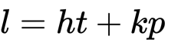
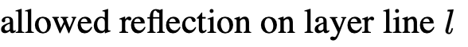
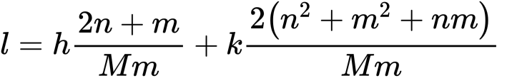
Selection rules
Fraunhofer diffraction can be calculated by convolution of the structure factor of the continuous helix and the equally spaced planes
The set of diffraction patterns of single continuous helices, whose particular origin lies in the points along the axis
When we include the geometry in the radial projection, we have
Notes:
For the allowed layer lines

Slide 9
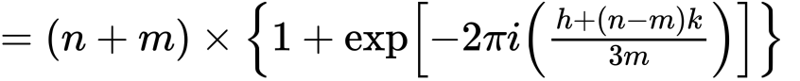
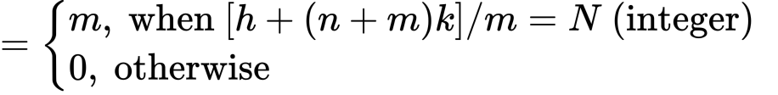
Structure factor of carbon nanotube
Notes:
The above equations are also valid for X-rays, when V(~r)
and f are replaced by the electron charge density function, r(~r), and the atomic scattering amplitude for X-rays, f(x), respec- tively.

Slide 10
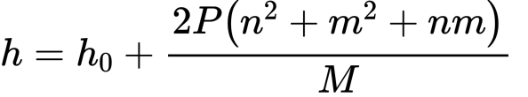
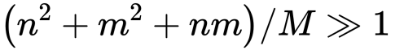
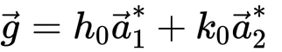
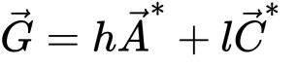
Determination of chiral indices
Three principle layer lines, the reflections with Miller indices
For one layer line:
Dominated by lowest order of Bessel function ( )
To obtain the order of the primary operating Bessel function for a given carbon nanotube (n,m), consider the allowed Bragg reflections for the Fraunhofer diffraction pattern in the graphene lattice
Basis vectors of the reciprocal lattice of the radial projection

Slide 11
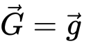
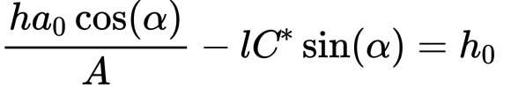
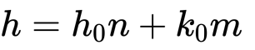
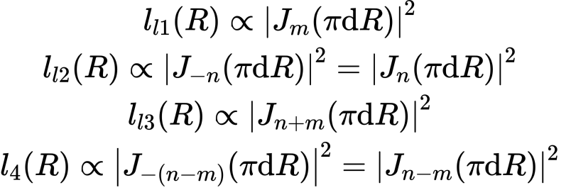
Determination of chiral indices (cont.)
The reflection indexed using the radial projection should be equivalent with the reciprocal lattice point indexed using the graphene lattice
Geometry (from dot product)

Slide 12
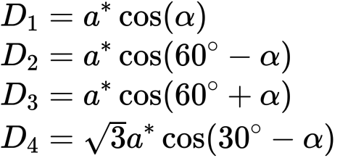
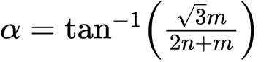
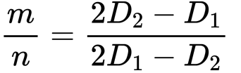
Ratio of chiral indices m/n
Using the geometry from the past two slides, we can find the spacing between the layer lines
We can determine the ratio of the chiral indices using the spacing of the layer lines above and our definition for the chiral angle,

Slide 13
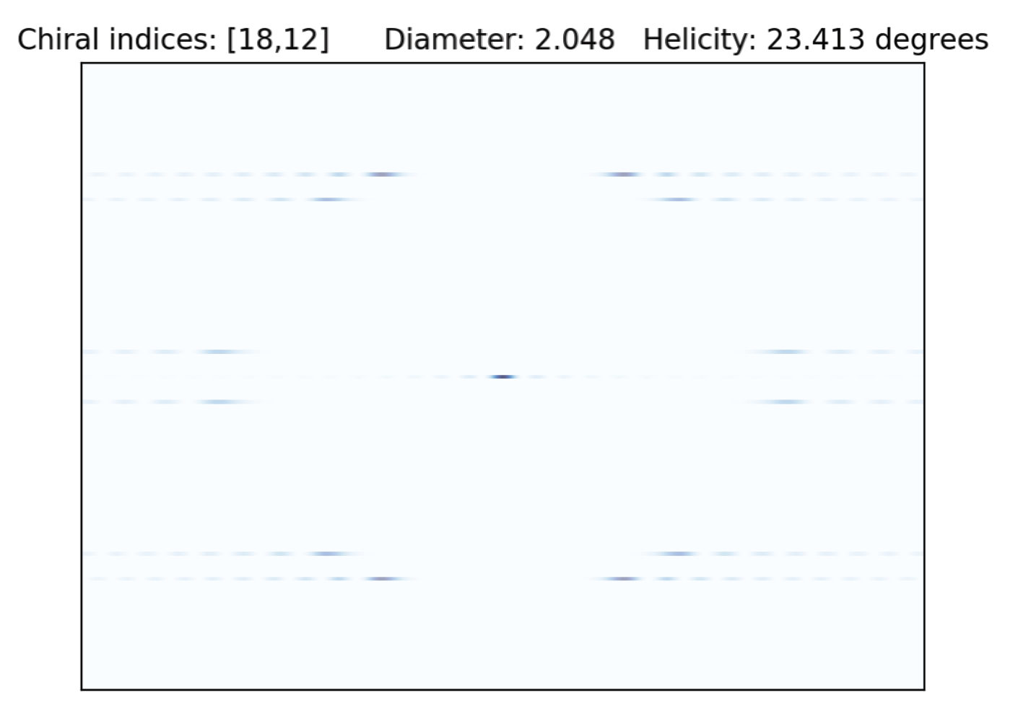
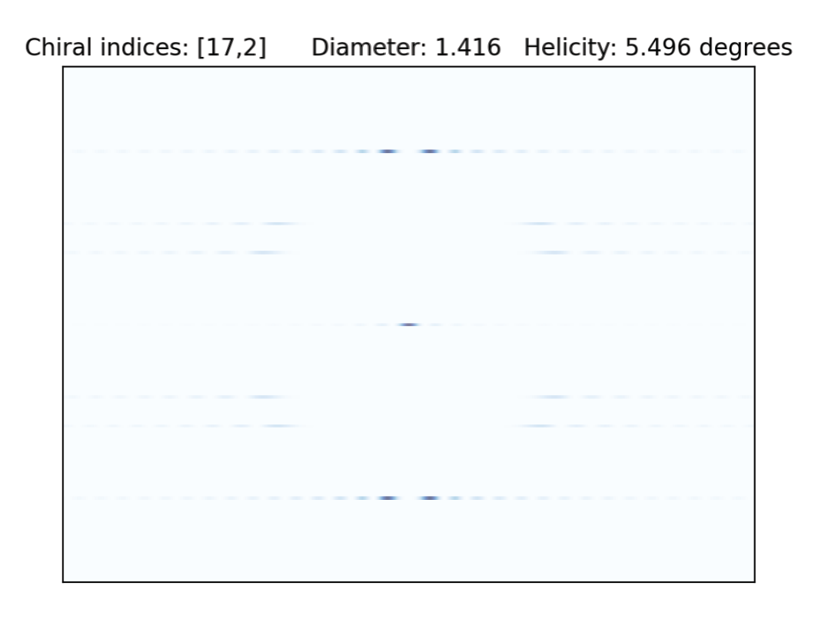
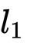
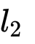
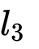
Simulation of diffraction patterns of single-wall carbon nanotubes

Slide 14
High precision determination of indices
Use a Convolutional Neural Network (typical Hough Transform, template matching have tradeoff between precision and computational cost)
Generate thousands of training images to train on (with noise term, rotated, cut)
Find (1) ‘center’, layer line l_{0,} (2) find other layer lines with another architecture, (3) use pixel distance between lines to determine ratio m/n with

Slide 15
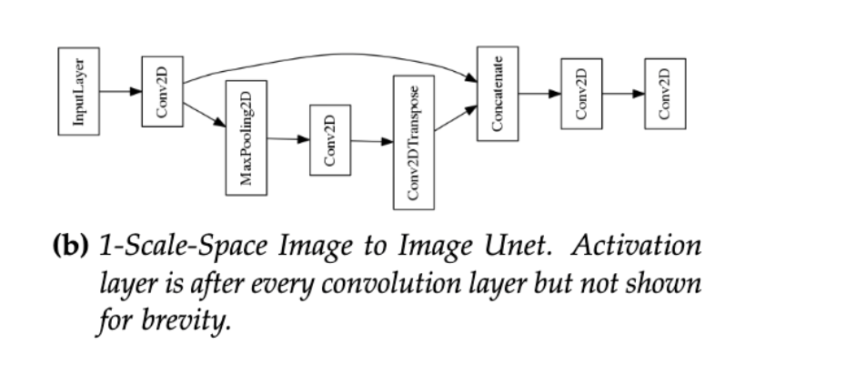
Current ConvNet architecture

Slide 16
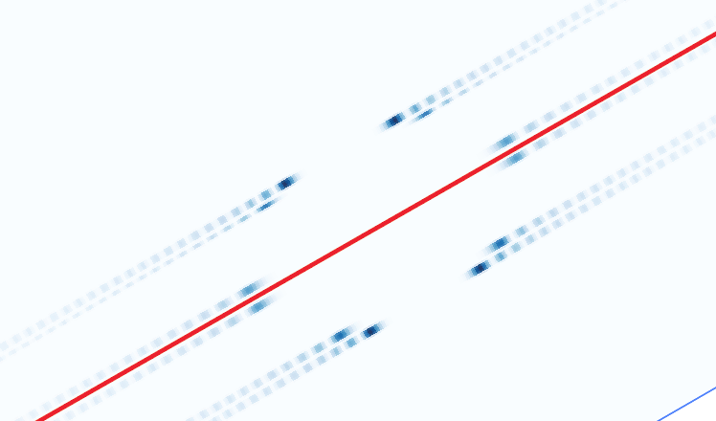
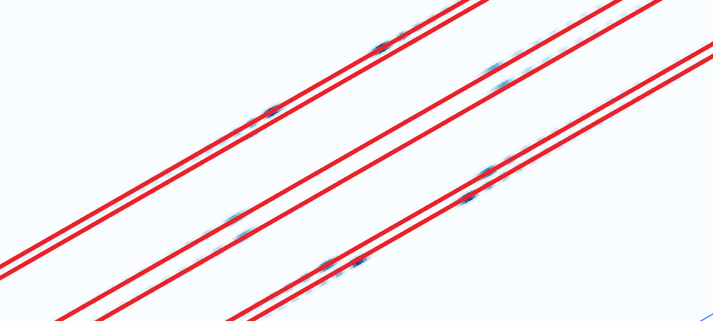
Preliminary results
In this example, the ratio was correctly determined as 2/3
Improvements needed: uncertainty analysis, direct determination of layer lines

Slide 17
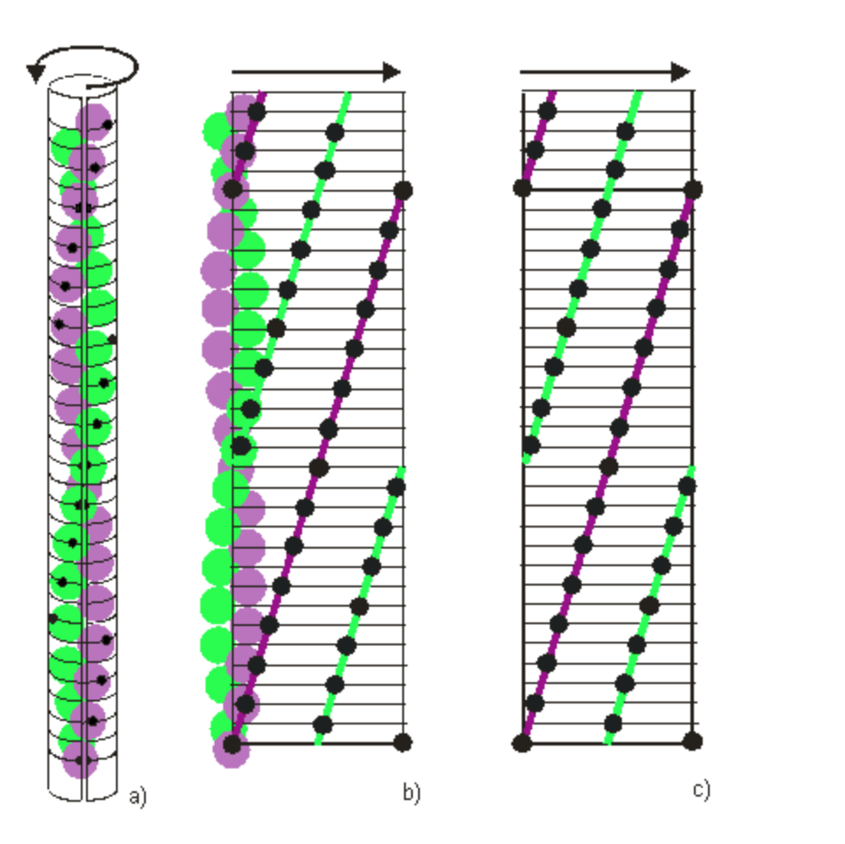
Appendix
Explanation of radial projection
https://www.diamond.ac.uk/Instruments/Soft-Condensed-Matter/small-angle/SAXS-Software/CCP13/HELIX.html#Theradialprojection

Slide 18
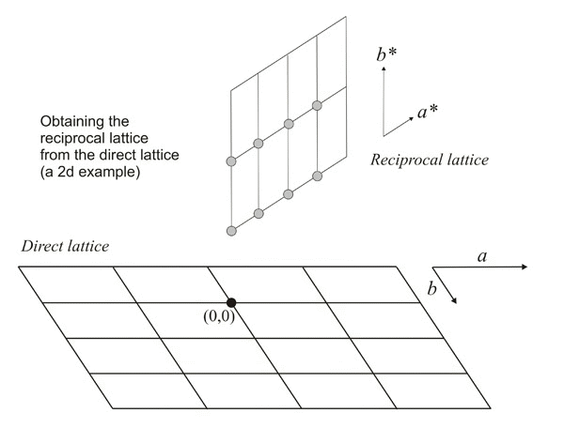
Reciprocal lattice

